Slide 1

Text Processing For NLP Word2Vec
Natural Language Processing is a complex field that relies on various text processing techniques to understand and generate human language. One of the most popular techniques is Word2Vec. In this presentation, we will explore the mechanics, applications, and challenges of Word2Vec.

Slide 2
Navigating Text Processing Techniques in NLP
Tokenization
Lemmatization
Breaking text into words or phrases.
Reducing words to their base form.
Stop Words Removal
Part-Of-Speech Tagging
Removing common words with no significant meaning like "the", "and", "a".
Identifying the syntactical properties of words.

Slide 3
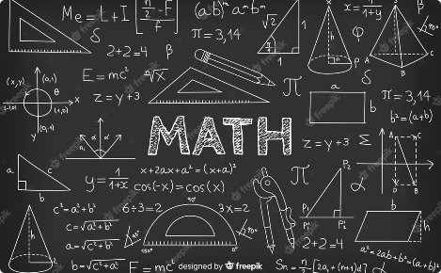
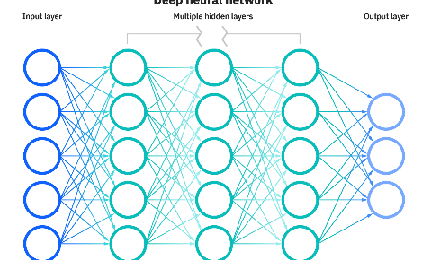

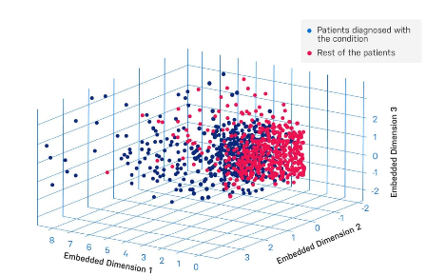
Demystifying Word2Vec: A Brief Overview
Vectors
Neural Networks
Are mathematical representations of words.
Learn the relationships between words.
Training
Embeddings
Consists of adjusting the network to create a more accurate representation of words.
Are the output of Word2Vec, which provides a numerical way to represent words.

Slide 4
Unveiling the Mechanics of Word2Vec
1
2
3
CBOW Model
Skip-Gram Model
Hierarchical Softmax
Predicts the target word based on its surrounding context words.
Predicts the context words based on the target word.
Transforms the problem of predicting one word into a set of binary decisions.

Slide 5
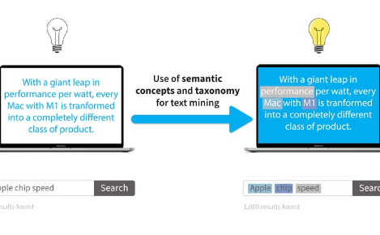


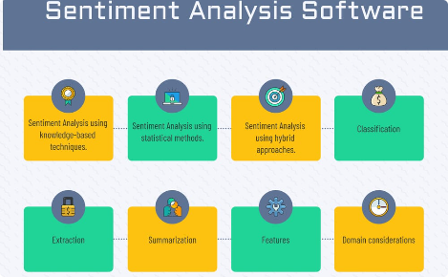
Word2Vec Applications in NLP: Enhancing Semantic Understanding
Semantic Search
Question Answering
Chatbots
Teaching machines to understand human language better.
Matching synonyms, antonyms, and related concepts.
Providing answers to questions by understanding the meaning behind them.
Sentiment Analysis
Classifying text as positive, negative, or neutral based on the meaning of the words.

Slide 6

Amplifying NLP with Word Embeddings: Real-world Use Cases
1
Amazon Rekognition
2
Google Translate
Uses Word2Vec and other algorithms to recognize objects and faces in images.
Uses Word2Vec to improve machine translation by understanding the meaning of words.
3
Spotify
4
Google News
Uses Word2Vec to recommend songs based on the meaning behind the lyrics.
Uses Word2Vec to group related articles based on the meaning of the words.

Slide 7
Grasping Word2Vec's Limitations and Challenges
Limitations
Challenges
Ignorance of concepts and semantic structure
Optimizing algorithm performance
Difficulty handling rare words or complex phrases
Reducing the dimensionality of vectors
Dealing with out-of-vocabulary words and misspellings
Lack of accounting for different word senses

Slide 8

Overcoming Ambiguity: Enhancing Polysemy and Homonymy Handling
With too many possible meanings for a word, polysemy and homonymy can create ambiguity. To tackle this issue, researchers have proposed various methods like using WordNets for context, syntactical analysis, or clustering methods to group similar word senses. A more recent trend is using contextualized embeddings, which take into account the whole sentence or paragraph to generate more accurate embeddings.

Slide 9
Scalability Concerns: Managing Vast Vocabularies
As the size of the vocabulary increases, so does the complexity of the Word2Vec model. To cope with this issue, several architectures have been proposed:
1
2
3
Hierarchical Softmax
Negative Sampling
Subsampling
Organizes the words in a binary tree structure, reducing computations.
Trains the model to distinguish between correct and incorrect word-context pairs.
Samples less frequent words and removes likely uninformative stop words to speed up the training.

Slide 10
Recommendations: Incorporating Word2Vec Effectively
Understand Your Data
Experiment with Different Architectures
Choose the adequate preprocessing steps and parameters.
Test different models and hyperparameters to assess which one performs best.
Use Pretrained Models
Evaluate on Task-relevant Metrics
If you lack sufficient data, consider using pre-trained models that are publicly available.
Assess your model's performance based on the task at hand, not just the raw accuracy.

Slide 11

Shaping the Future: Word2Vec in Evolving NLP Landscape
Despite its limitations, Word2Vec has been a game-changer in the area of Natural Language Processing and continues to shape the field. As research progresses, we can expect it to be combined with other techniques and morphed into more advanced algorithms. Furthermore, the trend towards pre-trained large-scale language models suggests that the future of Word2Vec lies not merely in semantically accurate embeddings but in models that can reason with and generate human-like text.

Slide 12

Conclusion: Reflecting on Word2Vec's Contributions to NLP
Word2Vec has revolutionized the way NLP is done by providing a way to mathematically represent words and their relationships. Although it comes with its limitations, it has enabled us to tackle more complex NLP tasks and created new opportunities for research and applications. As NLP evolves, we will continue to build upon the foundations laid by Word2Vec and other pioneers in the field.

